Slide 1
Potential Ideas for Wing Luke Museum
Team: Evelyn Durbin, Robert Castillo, Elliot Blaufuss, Eden Chung, Bryan Yee, Uladzislau Ustsamchuk

Slide 2
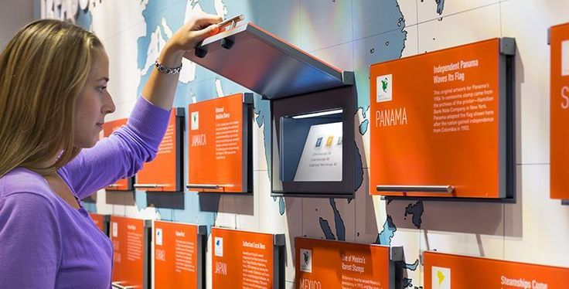
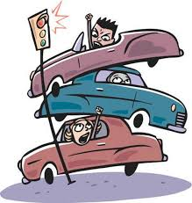
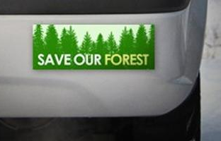
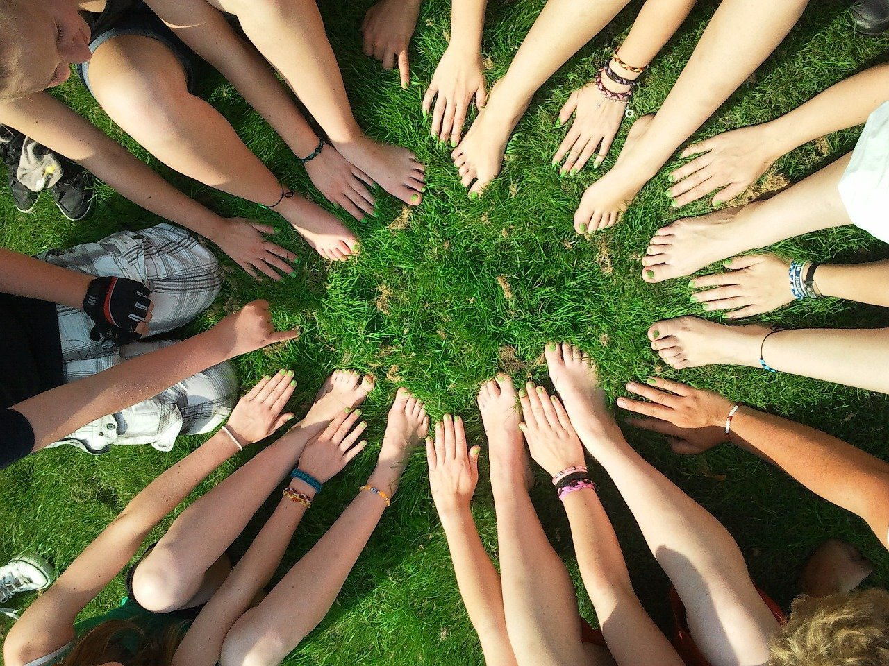
Overview
Interactive Display
Gamify Rewards Program
Marketing Work
Parking App
Incentives
Group Activity
Notes:
Interactive Display
Might not be doable in the time we have
Marketing work
Doable and we have done before
Group activity
Doable
How to do in covid times?
Incentives
How to produce? Is it enough for a capstone project?
Parking app
We can make prototype but needs coding
Don’t know how effective it will actually be
Gamify Rewards Program
Is this enough for a capstone project?

Slide 3
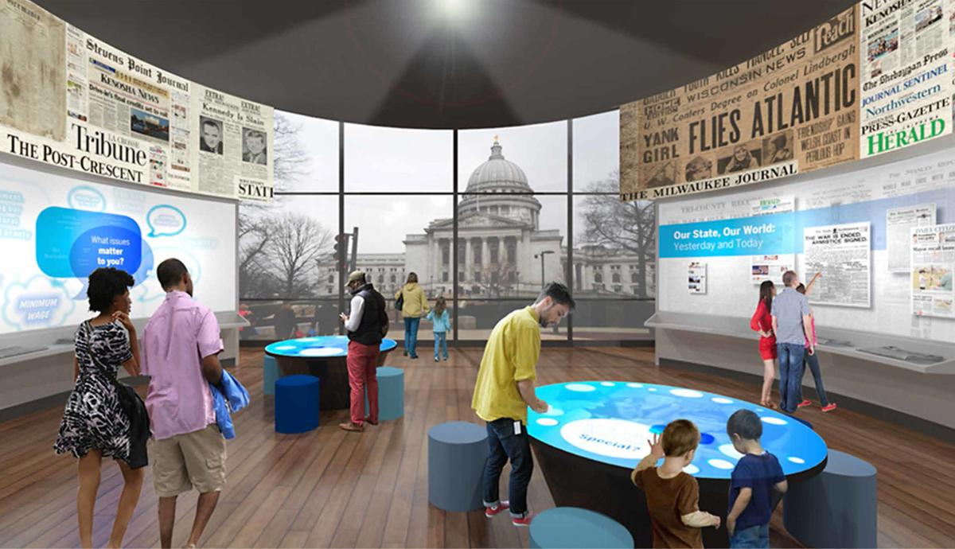
New Interactive Display
Rather than create something entirely new, instead design something which compliments the upcoming App.
Asked (Pain Point):
Low amount of people planning to come in
Solution:
New interactive display
Impact:
Solve the issue of lack of engagement

Slide 4
Pro’s:
Guaranteed to be Covid friendly
Interesting user experience
Might capture attention of younger audience
Accessible due to visuals and language barriers
Con’s
People might spend more time on phones
We don’t know what is on the app
Is this feasible given our amount of time?
We don’t know if there is space for another display

Slide 5
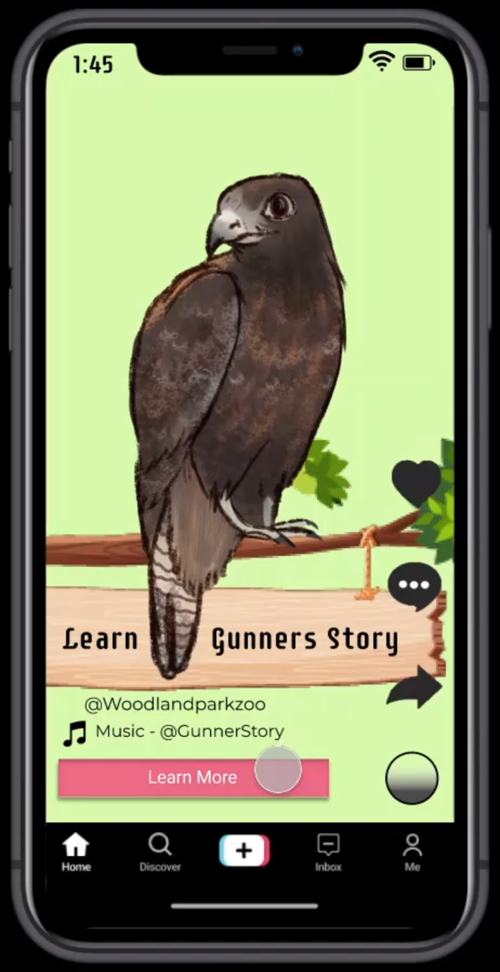
Marketing Work
Design something which will market the Museum to the public & spread awareness of its existence.
Asked (Pain Point):
Low amount of people planning to come in
Solution:
Marketing work to introduce users to museum
Impact:
Build community and have more people be aware of events

Slide 6
Pro’s:
Will increase awareness of the Museum
Increase online presence
Within our time limit & budget
Introduce people to the culture
We have experience in this field
Also Guaranteed to be covid friendly
Con’s
May not appeal to entire target audience
We are unaware of the outcome and what the ideal marketing strategy is for the user

Slide 7
Group Activity
Have various alternating week to week activities which will increase interaction. Which would follow covid precautions.
Asked (Pain Point):
Build tighter user community
Solution:
Activity plans such as a painting club or jeopardy night Game design
Impact:
Have incentive for users to come back

Slide 8
Pro’s:
Test different forms of interaction & see which ones are most effective
Already have a place to host the events if physical
Possible to host online
Will further build & tighten the community
Could encourage other people to join
Con’s
Uncertain how to get people to join activity
Possible time constraints

Slide 9
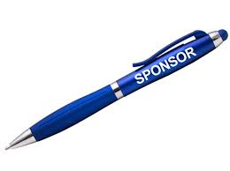
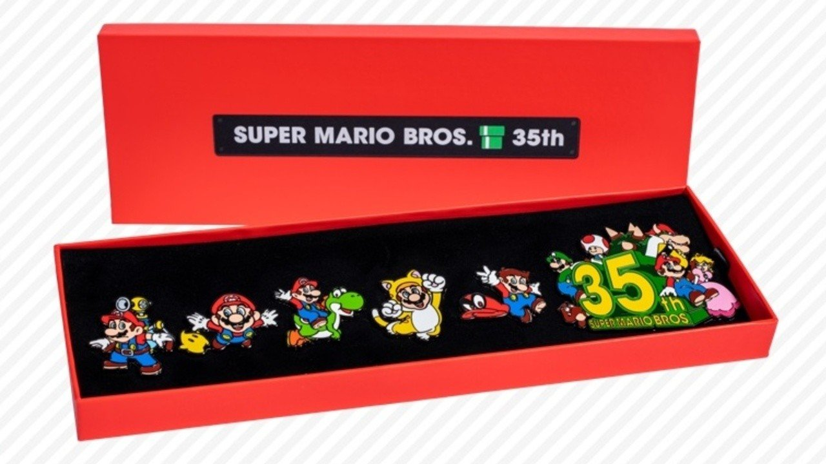
Incentives
Design reward(s) for continued support to the museum with incentive to encourage memberships & revisits.
Asked (Pain Point):
People don't often return or buy memberships
Solution:
Reward those who continue to support it
Impact:
Will get more memberships & returning visitors
Notes:
Incentives:
Bumper stickers
Souvenir from museum (nod to ancient pens)

Slide 10
Pro’s:
Receive more returning visitors
Encourage visitors to buy memberships
Could be cool
Con’s
Could be waste of resources as it doesn’t guarantee memberships
Possibly environmentally unaware
Production could be hard
HAS to be cool

Slide 11
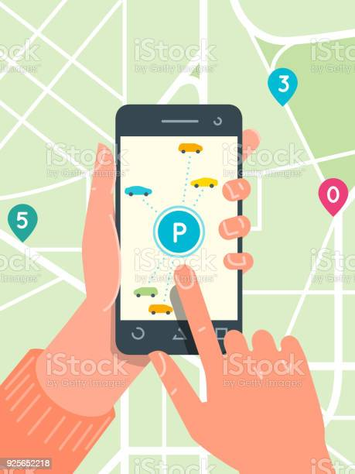
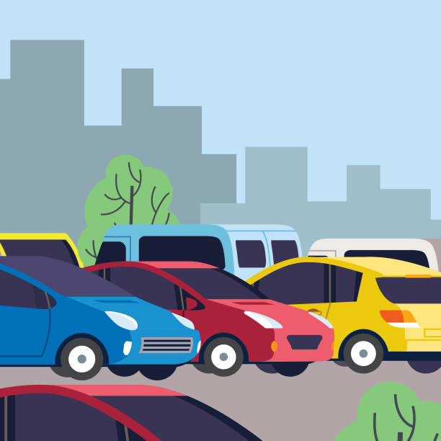
Parking App
A parking app might help users find local parking around the museum.
Asked (Pain Point):
Parking can be really difficult.
Solution:
Parking App
Impact:
Visitors will get a better experience on getting to the museum.

Slide 12
Pro’s:
Could be a nice link on the website for directions
Convenient for first time visitors
Con’s
We can design the app, but we would need someone else to code it
We don’t know how helpful it would actually be

Slide 13
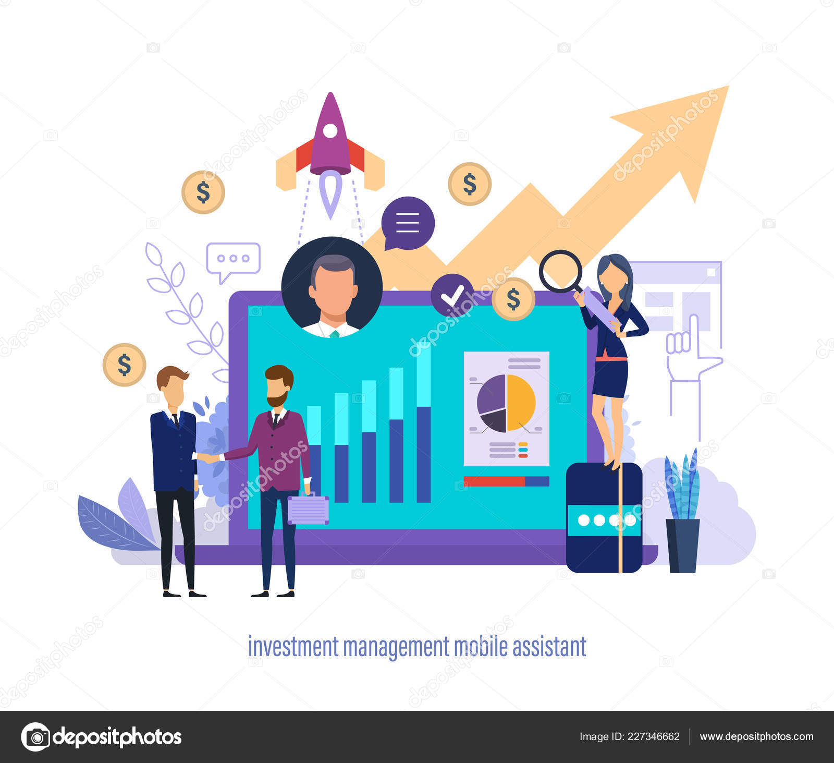
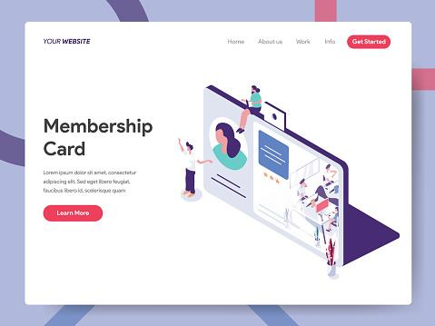
Gamify Rewards Program
Point based system where if gained enough points might gain a free visit or some sort of reward.
Asked (Pain Point):
People don't often return or buy memberships
Solution:
Reward those who continue to support it
Impact:
Will get more memberships & returning visitors

Slide 14
Pro’s:
Appeal to younger audience
Encourage Museum exploration
Encourage revisits
Increases museum interaction
Con’s
Could be implemented in the upcoming app
People might spend a lot of time on their phones

Slide 15
So, what is possible?
Interactive Display
Gamify Rewards Program
Marketing Work
Parking App
Incentives
Group Activity
Notes:
Interactive Display
Might not be doable in the time we have
Marketing work
Doable and we have done before
Group activity
Doable
How to do in covid times?
Incentives
How to produce? Is it enough for a capstone project?
Parking app
We can make prototype but needs coding
Don’t know how effective it will actually be
Gamify Rewards Program
Is this enough for a capstone project?

Slide 16
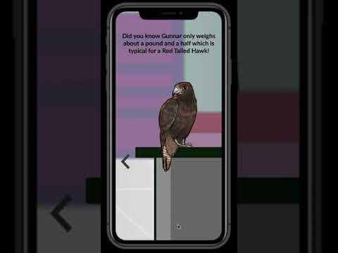
Promotional Video
Notes:
Link to work in progress Research Report:
https://www.evelyndurbin.com/_files/ugd/107076_ca0c370fd44c47389c6b5117bd394d4a.pdf

